Slide 1
Complete Flow Chart - Library
Version 1
ONLL w/ losses
ONLL w/o losses
+5, -0
+10, -10
+0, -2
+0, -5
+5, -0
+10, -0
+20, -0
+0, -0
OLL
ONLL w/ and w/o losses
+5, -0
+20, -0
+10, -0
+5, -10
+0, -20
+5, -5
Lib

Slide 2
Complete Flow Chart - Office
Version 1
OLL
ONLL w/ losses
ONLL w/o losses
+0, -10
+0, -5
+20, -0
+5, -2
+5, -0
+0, -10
+0, -5
+10, -10
ONLL w/o losses
ONLL w/ losses
+5, -5
+0, -20
+5, -0
+5, -2
+10, -5
+5, -0
Office

Slide 3
Version 1
ONLL
OLL
8
9
10
11
12
13
14
15
8
9
10
11
12
13
14
15
4
5
6
7
4
5
6
7
2
3
2
3
Lib Entrance (lib_1)
Office Entrance (office_1)

Slide 4
Version 2
15
14
13
12
11
10
9
8
11
10
9
8
15
14
13
12
7
6
5
4
5
4
7
6
3
2
2
3
Lib Entrance (lib_1)
Office Entrance (office_1)

Slide 5
Version 3
11
10
9
8
15
14
13
12
15
14
13
12
11
10
9
8
5
4
7
6
7
6
5
4
2
3
3
2
Lib Entrance (lib_1)
Office Entrance (office_1)

Slide 6
How many invites ACCEPTED/REJECTED will you receive in the next room?
CORRECT
INCORRECT

Slide 7
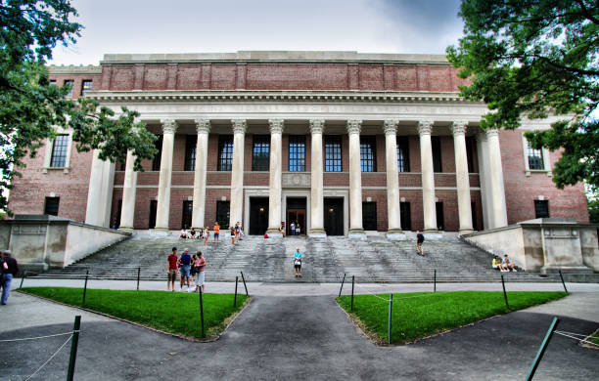
Notes:
Lib_1

Slide 8
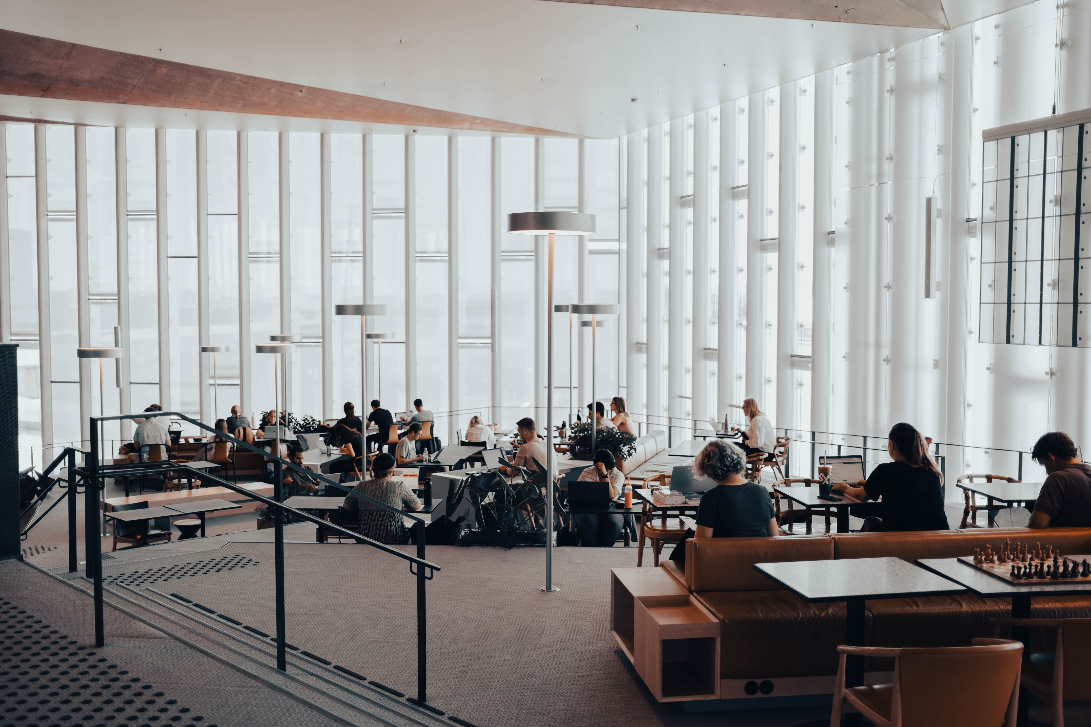
Invites accepted:
Invites rejected:
Notes:
Lib_2

Slide 9
Invites accepted:
0
Invites rejected:
20
Not interested
Not interested
Not interested
Not interested
Not interested
Not interested
Not interested
Not interested
Not interested
Not interested
Not interested
Not interested
Not interested
Not interested
Not interested
Not interested
Not interested
Not interested
Not interested
Not interested
Notes:
Lib_2

Slide 10
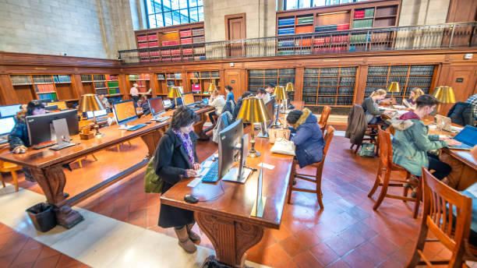
Invites accepted:
Invites rejected:
Notes:
Lib_3

Slide 11
Invites accepted:
5
Invites rejected:
5
Sure, I’ll come!
Sure, I’ll come!
Not interested
Sure, I’ll come!
Sure, I’ll come!
Not interested
Sure, I’ll come!
Not interested
Not interested
Not interested
Notes:
Lib_3

Slide 12

Invites accepted:
Invites rejected:
Notes:
Lib_4

Slide 13
Invites accepted:
5
Invites rejected:
0
Sure, I’ll come!
Sure, I’ll come!
Sure, I’ll come!
Sure, I’ll come!
Sure, I’ll come!
Notes:
Lib_4

Slide 14
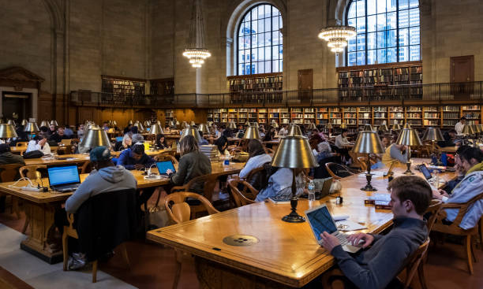
Invites accepted:
Invites rejected:
Notes:
Lib_5

Slide 15
Invites accepted:
20
Invites rejected:
0
Sure, I’ll come!
Sure, I’ll come!
Sure, I’ll come!
Sure, I’ll come!
Sure, I’ll come!
Sure, I’ll come!
Sure, I’ll come!
Sure, I’ll come!
Sure, I’ll come!
Sure, I’ll come!
Sure, I’ll come!
Sure, I’ll come!
Sure, I’ll come!
Sure, I’ll come!
Sure, I’ll come!
Sure, I’ll come!
Sure, I’ll come!
Sure, I’ll come!
Sure, I’ll come!
Notes:
Lib_5

Slide 16
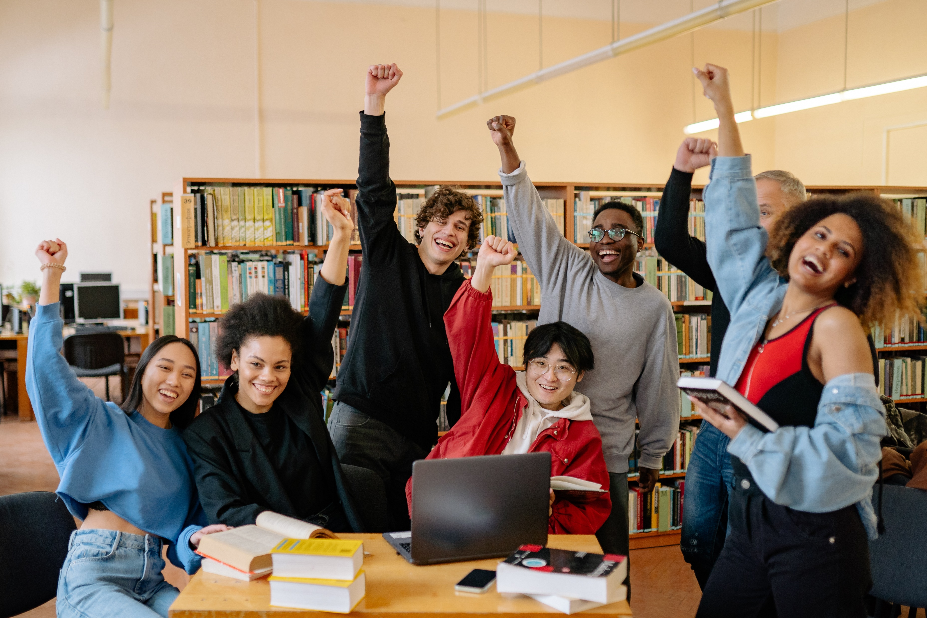
Invites accepted:
Invites rejected:
Notes:
Lib_6

Slide 17
Invites accepted:
10
Invites rejected:
0
Sure, I’ll come!
Sure, I’ll come!
Sure, I’ll come!
Sure, I’ll come!
Sure, I’ll come!
Sure, I’ll come!
Sure, I’ll come!
Sure, I’ll come!
Sure, I’ll come!
Sure, I’ll come!
Notes:
Lib_6

Slide 18
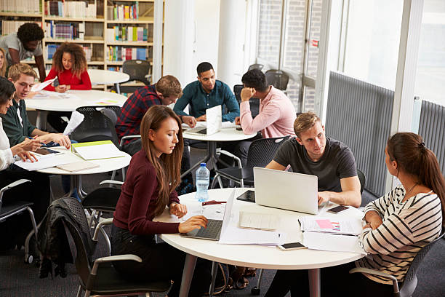
Invites accepted:
Invites rejected:
Notes:
Lib_7

Slide 19
Invites accepted:
5
Invites rejected:
10
Not interested
Sure, I’ll come!
Not interested
Sure, I’ll come!
Sure, I’ll come!
Not interested
Not interested
Not interested
Not interested
Sure, I’ll come!
Not interested
Sure, I’ll come!
Not interested
Not interested
Not interested
Notes:
Lib_7

Slide 20
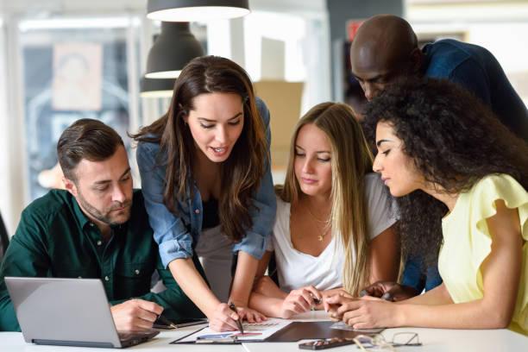
Invites accepted:
Invites rejected:
Notes:
Lib_8

Slide 21
Invites accepted:
5
Invites rejected:
0
Sure, I’ll come!
Sure, I’ll come!
Sure, I’ll come!
Sure, I’ll come!
Sure, I’ll come!
Notes:
Lib_8

Slide 22
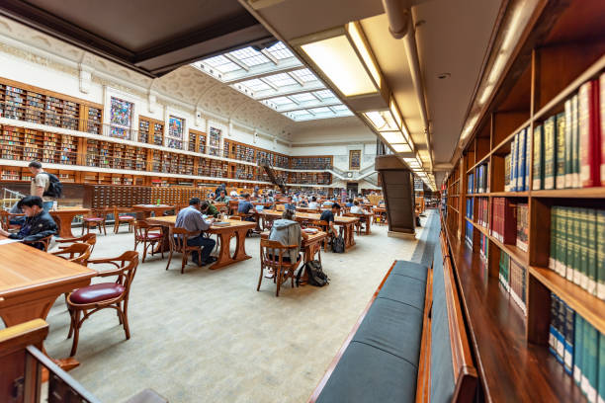
Invites accepted:
Invites rejected:
Notes:
Lib_9

Slide 23
Invites accepted:
10
Invites rejected:
10
Sure, I’ll come!
Sure, I’ll come!
Not interested
Sure, I’ll come!
Not interested
Not interested
Not interested
Not interested
Sure, I’ll come!
Sure, I’ll come!
Sure, I’ll come!
Not interested
Not interested
Sure, I’ll come!
Sure, I’ll come!
Sure, I’ll come!
Not interested
Not interested
Sure, I’ll come!
Not interested
Notes:
Lib_9

Slide 24
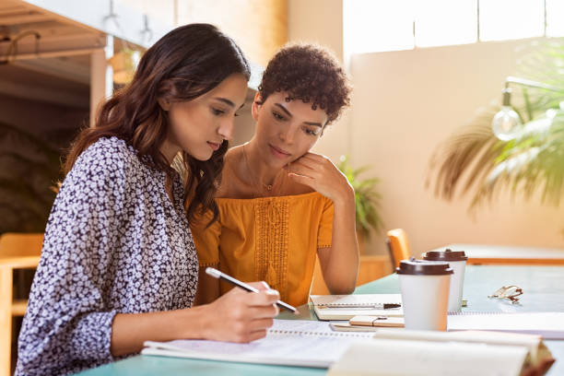
Invites accepted:
Invites rejected:
Notes:
Lib_10

Slide 25
Invites accepted:
0
Invites rejected:
2
Not interested
Not interested
Notes:
Lib_10

Slide 26
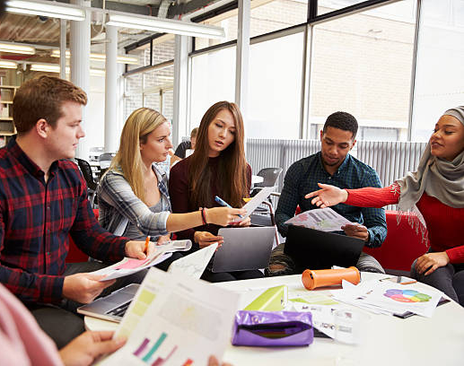
Invites accepted:
Invites rejected:
Notes:
Lib_11

Slide 27
Invites accepted:
0
Invites rejected:
5
Not interested
Not interested
Not interested
Not interested
Not interested
Notes:
Lib_11

Slide 28
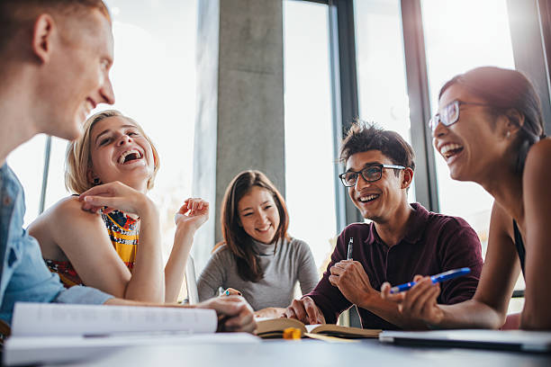
Invites accepted:
Invites rejected:
Notes:
Lib_12

Slide 29
Invites accepted:
5
Invites rejected:
0
Sure, I’ll come!
Sure, I’ll come!
Sure, I’ll come!
Sure, I’ll come!
Sure, I’ll come!
Notes:
Lib_12

Slide 30
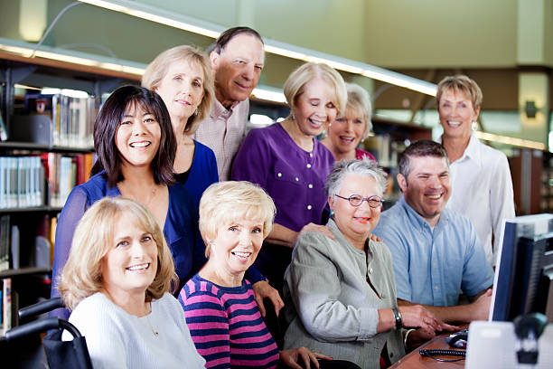
Invites accepted:
Invites rejected:
Notes:
Lib_13

Slide 31
Invites accepted:
10
Invites rejected:
0
Sure, I’ll come!
Sure, I’ll come!
Sure, I’ll come!
Sure, I’ll come!
Sure, I’ll come!
Sure, I’ll come!
Sure, I’ll come!
Sure, I’ll come!
Sure, I’ll come!
Sure, I’ll come!
Notes:
Lib_13

Slide 32
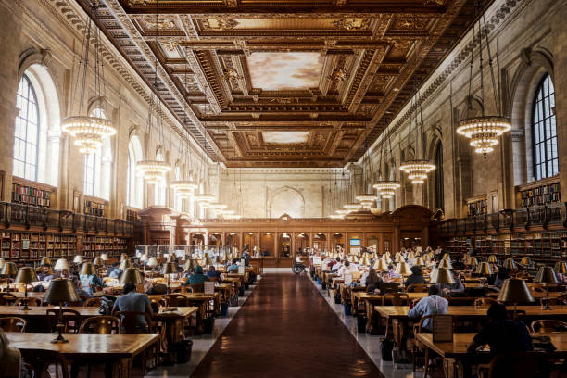
Invites accepted:
Invites rejected:
Notes:
Lib_14

Slide 33
Invites accepted:
20
Invites rejected:
0
Sure, I’ll come!
Sure, I’ll come!
Sure, I’ll come!
Sure, I’ll come!
Sure, I’ll come!
Sure, I’ll come!
Sure, I’ll come!
Sure, I’ll come!
Sure, I’ll come!
Sure, I’ll come!
Sure, I’ll come!
Sure, I’ll come!
Sure, I’ll come!
Sure, I’ll come!
Sure, I’ll come!
Sure, I’ll come!
Sure, I’ll come!
Sure, I’ll come!
Sure, I’ll come!
Sure, I’ll come!
Notes:
Lib_14

Slide 34
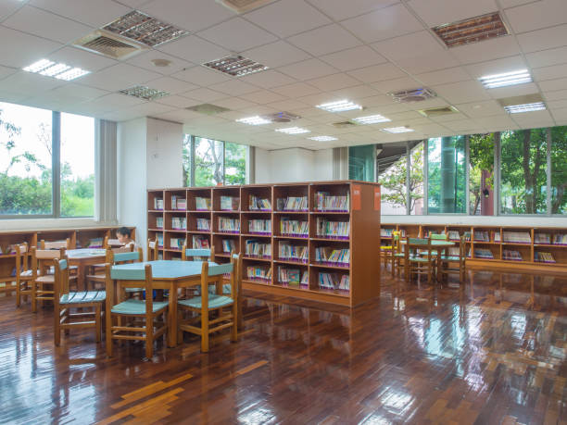
Invites accepted:
Invites rejected:
Notes:
Lib_15

Slide 35
Invites accepted:
0
Invites rejected:
0
Notes:
Lib_15

Slide 36
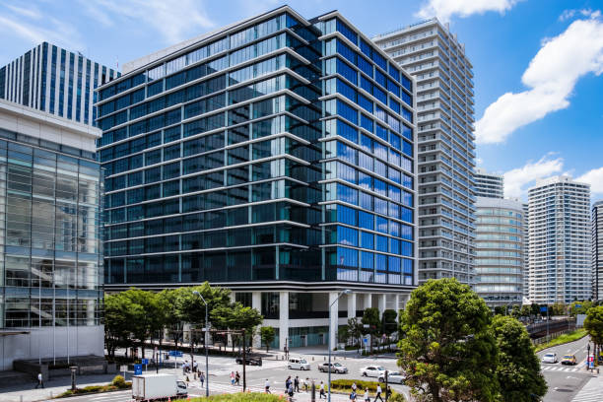
Notes:
Office_1

Slide 37
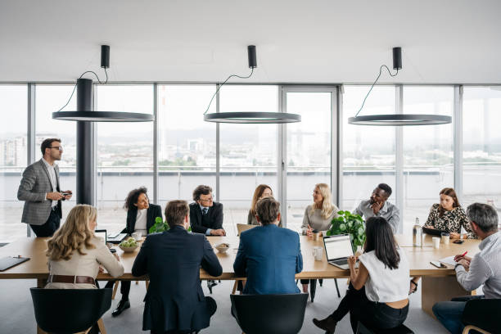
Invites accepted:
Invites rejected:
Notes:
Office_2

Slide 38
Invites accepted:
10
Invites rejected:
5
Sure, I’ll come!
Sure, I’ll come!
Not interested
Sure, I’ll come!
Sure, I’ll come!
Not interested
Not interested
Sure, I’ll come!
Sure, I’ll come!
Sure, I’ll come!
Sure, I’ll come!
Not interested
Not interested
Sure, I’ll come!
Sure, I’ll come!
Notes:
Office_2

Slide 39
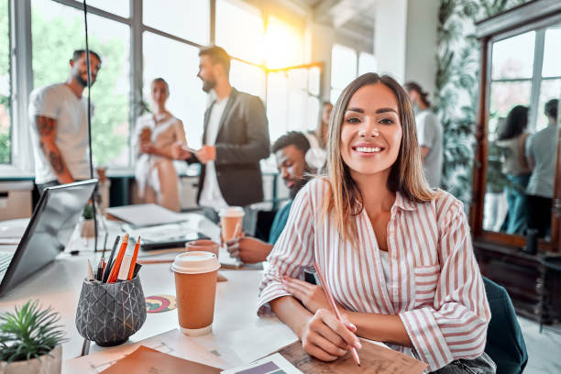
Invites accepted:
Invites rejected:
Notes:
Office_3

Slide 40
Invites accepted:
5
Invites rejected:
0
Sure, I’ll come!
Sure, I’ll come!
Sure, I’ll come!
Sure, I’ll come!
Sure, I’ll come!
Notes:
Office_3

Slide 41
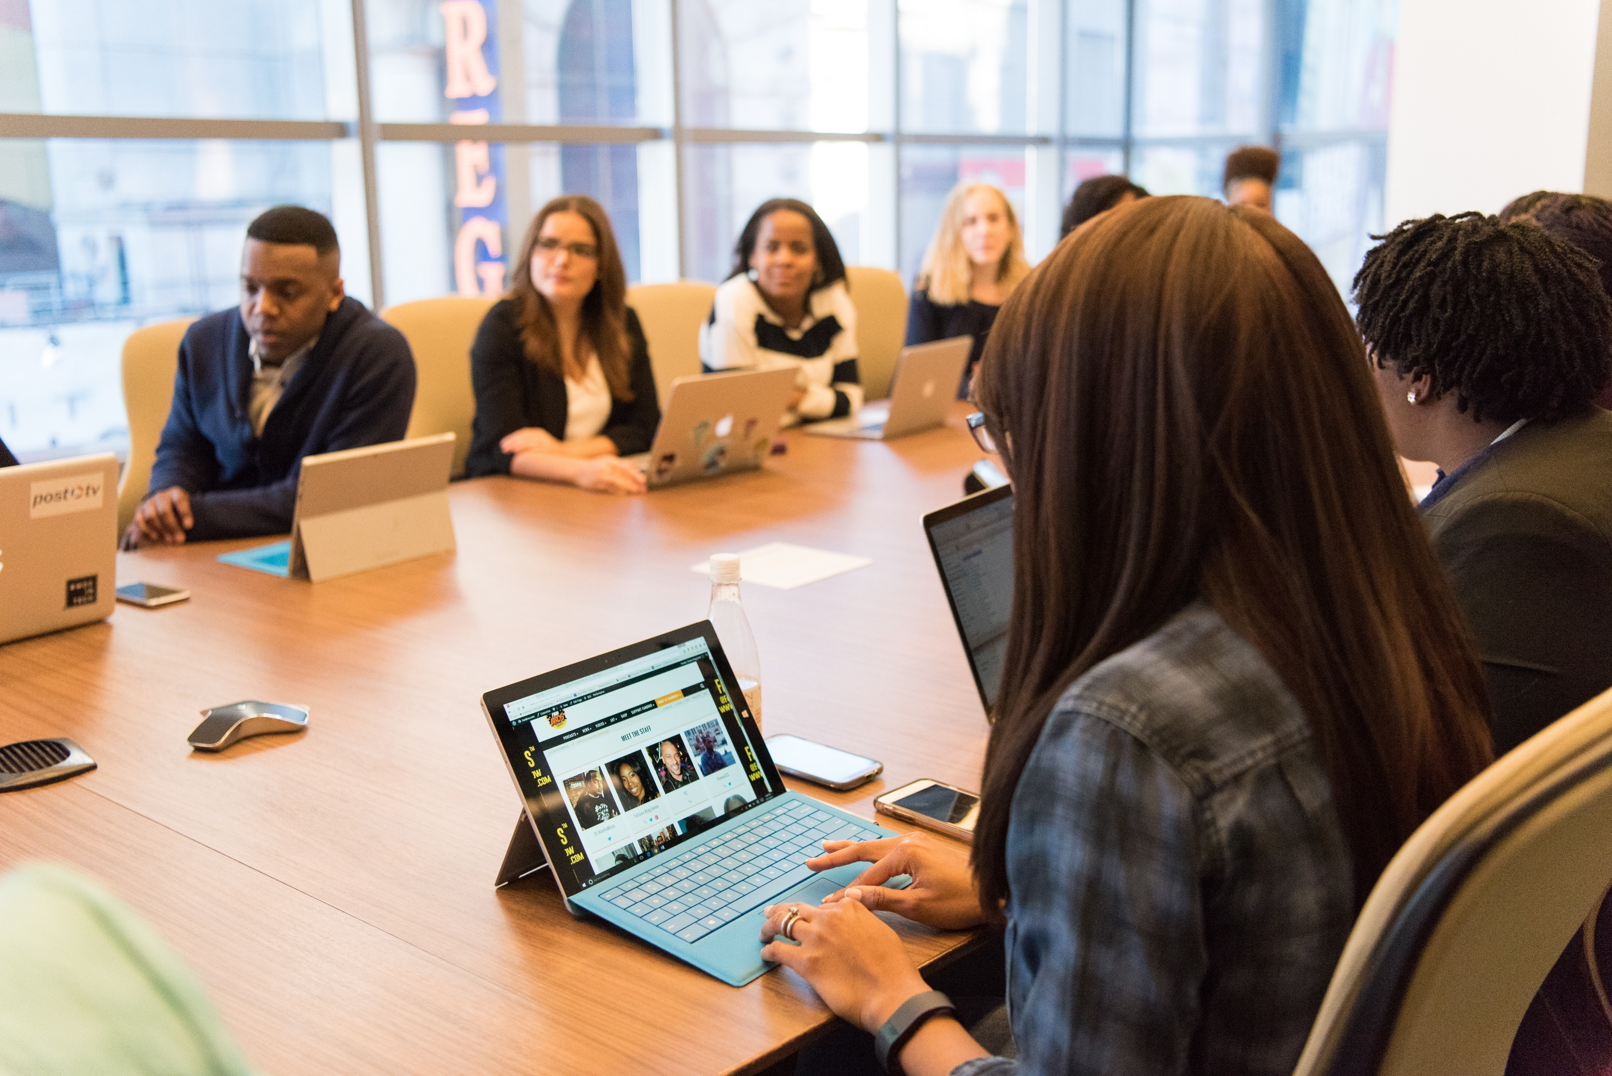
Invites accepted:
Invites rejected:
Notes:
Office_4

Slide 42
Invites accepted:
5
Invites rejected:
5
Sure, I’ll come!
Not interested
Not interested
Sure, I’ll come!
Not interested
Not interested
Not interested
Sure, I’ll come!
Sure, I’ll come!
Sure, I’ll come!
Notes:
Office_4

Slide 43
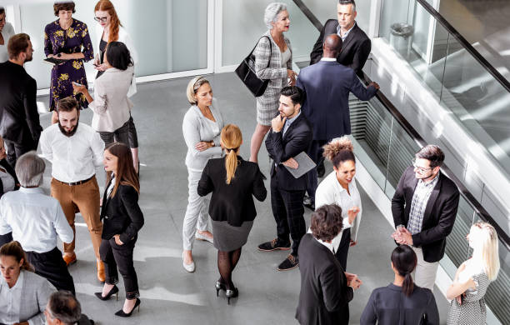
Invites accepted:
Invites rejected:
Notes:
Office_5

Slide 44
Invites accepted:
0
Invites rejected:
20
Not interested
Not interested
Not interested
Not interested
Not interested
Not interested
Not interested
Not interested
Not interested
Not interested
Not interested
Not interested
Not interested
Not interested
Not interested
Not interested
Not interested
Not interested
Not interested
Not interested
Not interested
Notes:
Office_5

Slide 45
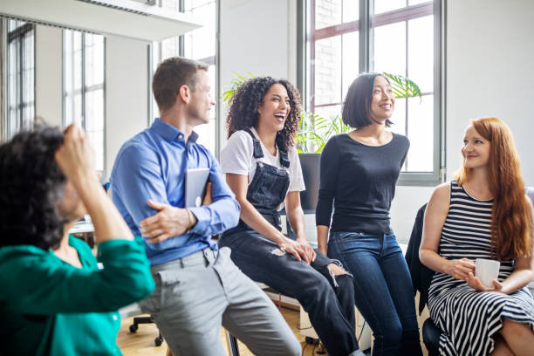
Invites accepted:
Invites rejected:
Notes:
Office_6

Slide 46
Invites accepted:
5
Invites rejected:
0
Sure, I’ll come!
Sure, I’ll come!
Sure, I’ll come!
Sure, I’ll come!
Sure, I’ll come!
Notes:
Office_6

Slide 47
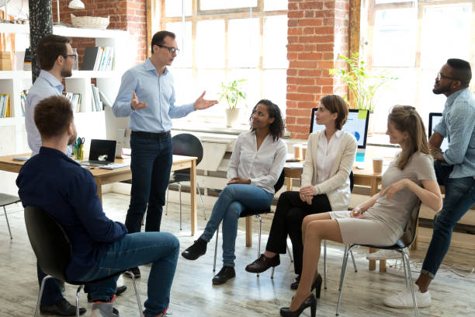
Invites accepted:
Invites rejected:
Notes:
Office_7

Slide 48
Invites accepted:
5
Invites rejected:
2
Sure, I’ll come!
Not interested
Sure, I’ll come!
Sure, I’ll come!
Sure, I’ll come!
Not interested
Sure, I’ll come!
Notes:
Office_7

Slide 49
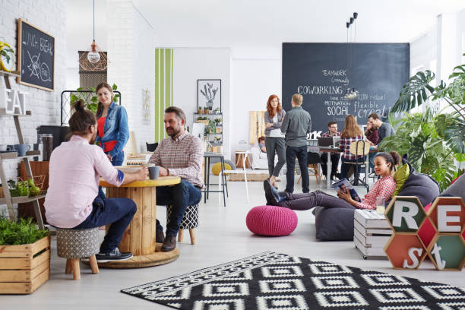
Invites accepted:
Invites rejected:
Notes:
Office_8

Slide 50
Invites accepted:
0
Invites rejected:
10
Not interested
Not interested
Not interested
Not interested
Not interested
Not interested
Not interested
Not interested
Not interested
Not interested
Notes:
Office_8

Slide 51
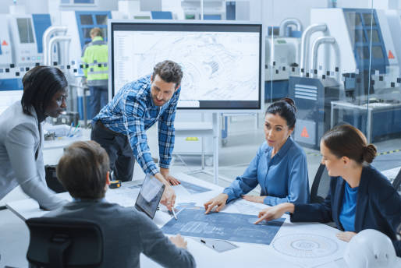
Invites accepted:
Invites rejected:
Notes:
Office_9

Slide 52
Invites accepted:
0
Invites rejected:
5
Not interested
Not interested
Not interested
Not interested
Not interested
Notes:
Office_9

Slide 53
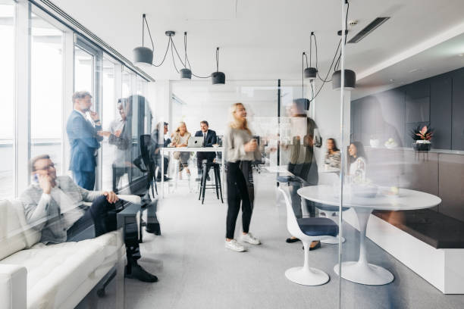
Invites accepted:
Invites rejected:
Notes:
Office_10

Slide 54
Invites accepted:
20
Invites rejected:
0
Sure, I’ll come!
Sure, I’ll come!
Sure, I’ll come!
Sure, I’ll come!
Sure, I’ll come!
Sure, I’ll come!
Sure, I’ll come!
Sure, I’ll come!
Sure, I’ll come!
Sure, I’ll come!
Sure, I’ll come!
Sure, I’ll come!
Sure, I’ll come!
Sure, I’ll come!
Sure, I’ll come!
Sure, I’ll come!
Sure, I’ll come!
Sure, I’ll come!
Sure, I’ll come!
Sure, I’ll come!
Notes:
Office_10

Slide 55
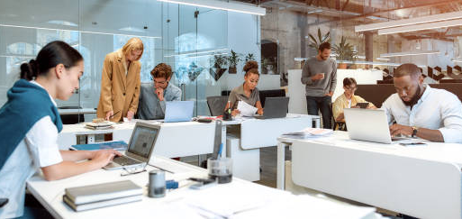
Invites accepted:
Invites rejected:
Notes:
Office_11

Slide 56
Invites accepted:
5
Invites rejected:
2
Sure, I’ll come!
Sure, I’ll come!
Not interested
Sure, I’ll come!
Sure, I’ll come!
Sure, I’ll come!
Not interested
Notes:
Office_11

Slide 57
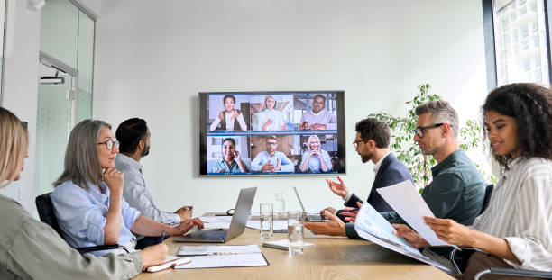
Invites accepted:
Invites rejected:
Notes:
Office_12

Slide 58
Invites accepted:
5
Invites rejected:
0
Sure, I’ll come!
Sure, I’ll come!
Sure, I’ll come!
Sure, I’ll come!
Sure, I’ll come!
Notes:
Office_12

Slide 59
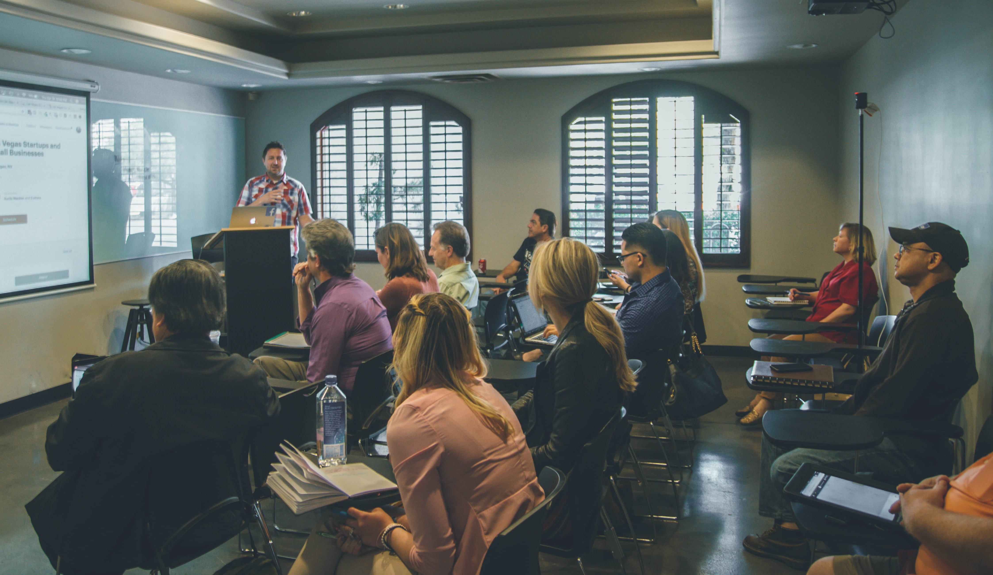
Invites accepted:
Invites rejected:
Notes:
Office_13

Slide 60
Invites accepted:
0
Invites rejected:
10
Not interested
Not interested
Not interested
Not interested
Not interested
Not interested
Not interested
Not interested
Not interested
Not interested
Notes:
Office_13

Slide 61
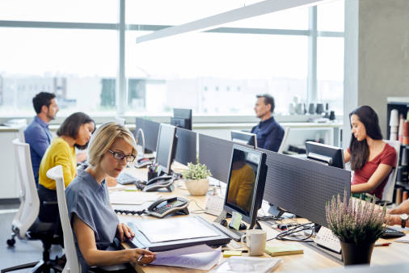
Invites accepted:
Invites rejected:
Notes:
Office_14

Slide 62
Invites accepted:
0
Invites rejected:
5
Not interested
Not interested
Not interested
Not interested
Not interested
Notes:
Office_14

Slide 63
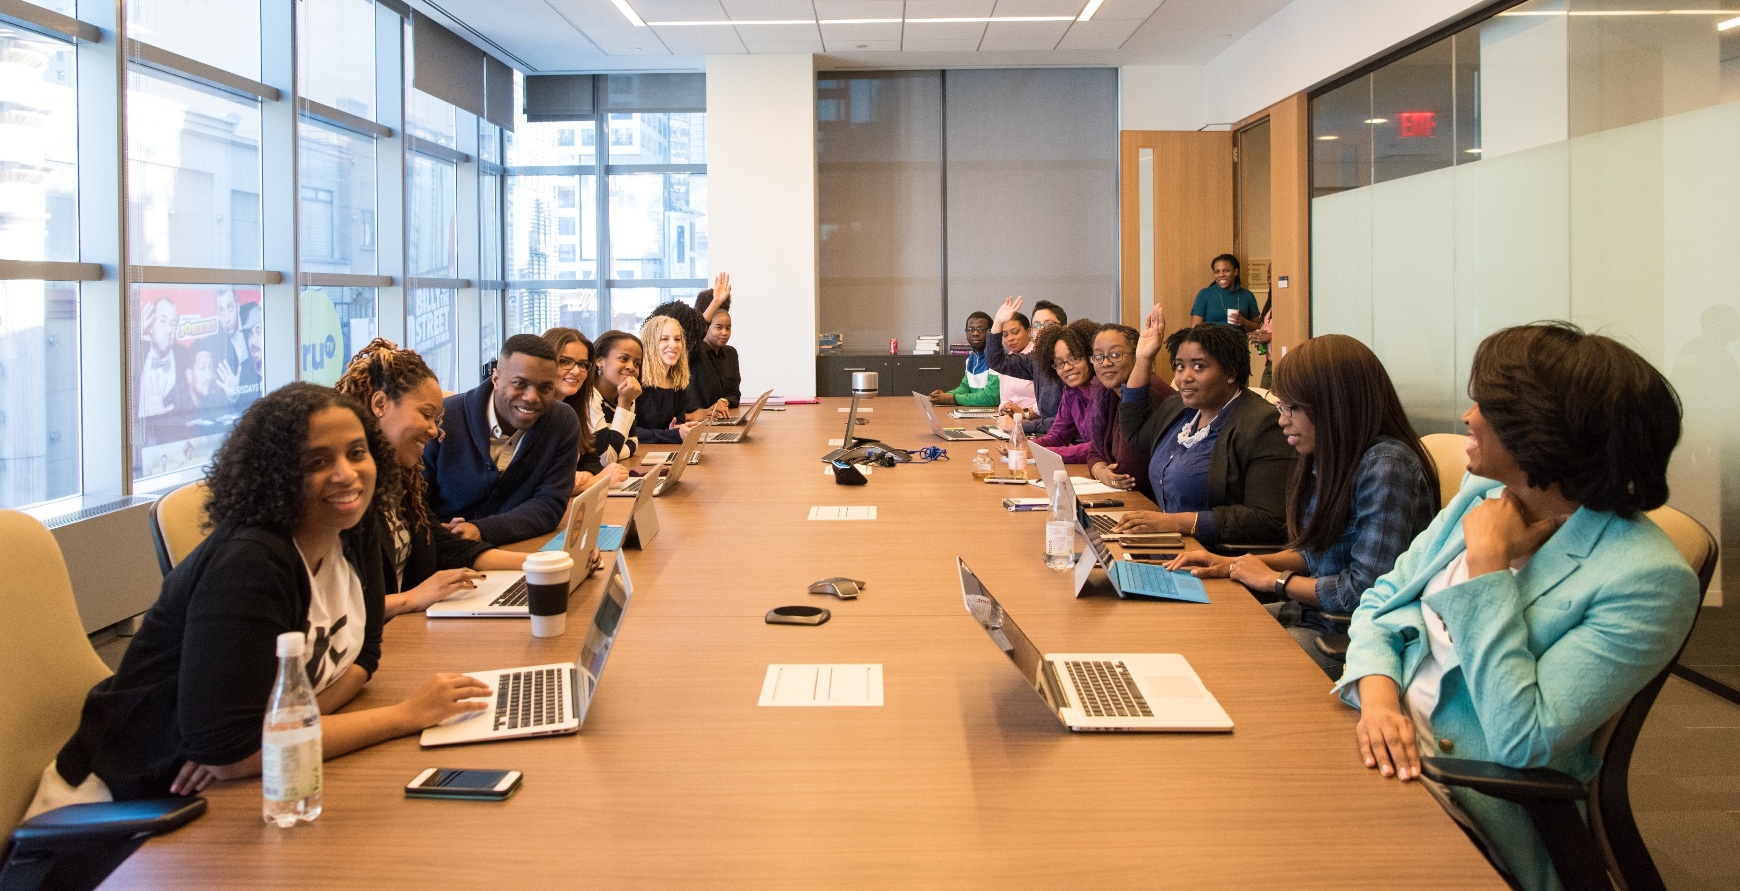
Invites accepted:
Invites rejected:
Notes:
Office_15

Slide 64
Invites accepted:
10
Invites rejected:
10
Sure, I’ll come!
Sure, I’ll come!
Not interested
Not interested
Not interested
Sure, I’ll come!
Not interested
Not interested
Not interested
Not interested
Sure, I’ll come!
Sure, I’ll come!
Sure, I’ll come!
Not interested
Sure, I’ll come!
Not interested
Sure, I’ll come!
Sure, I’ll come!
Not interested
Sure, I’ll come!
Notes:
Office_15

